Slide 1


Workshop on evaluating vaccine impact Evaluating Vaccine Impact using Time Series Data
Dan Weinberger, PhD
Epidemiology of Microbial Diseases
Yale School of Public Health

Slide 2
Acknowledgements
The development of this workshop was supported by a grant from the Bill and Melinda Gates Foundation
Much of the material in this workshop was jointly developed with:
Dr. Kayoko Shioda (Yale/Emory)
Dr. Cristiana Toscano (PAHO/Universidade Federal de Goiás)
Dr. Lucia Oliveira (PAHO)

Slide 3
Who is this workshop meant for?
Data analysts, practitioners, and students who are performing evaluations of the impact of vaccines and other public health interventions
Prerequisites: Knowledge of basic statistics (e.g., regression), familiarity with R is helpful but not required.

Slide 4
Topics covered in this workshop
Optional Introduction to R
Background on the use of administrative data and potential pitfalls
Interrupted time series analysis
Use of controls and synthetic controls
Presenting your findings and managing uncertainty

Slide 5
Workshop learning objectives
To understand the strengths and weaknesses of routinely-collected administrative data
To critically evaluate different methods for vaccine impact evaluation
To format and analyze real-world time series data

Slide 6
Hybrid Structure of the workshop
Recorded didactic presentations
“Live” interactive data analysis sessions via R Studio Cloud and ZOOM, with recordings archived
Accessibility: automatic English subtitles will be used on recorded sessions

Slide 7
Additional Resources
Draft guidance document from WHO on vaccine evaluation
https://danweinberger.github.io/who-guidance-materials

Slide 8
Does vaccine introduction have an effect on rates of hospitalization or death?

Slide 9
Types of studies to evaluate vaccines
Evaluating direct effect of a vaccine
on an individual’s risk of disease
A: Case, unvaccinated
Case-control studies
V
B: Case, vaccinated
V
V
V
C: Control, unvaccinated
V
V
V
D: Control, vaccinated
V
V
V
Vaccine effectiveness: 100* (1-(B/A)/(D/C))
Vaccine effectiveness: 100* (1-(3/4)/(5/2))=70%

Slide 10
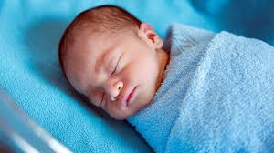
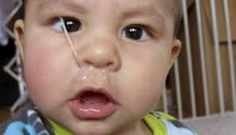

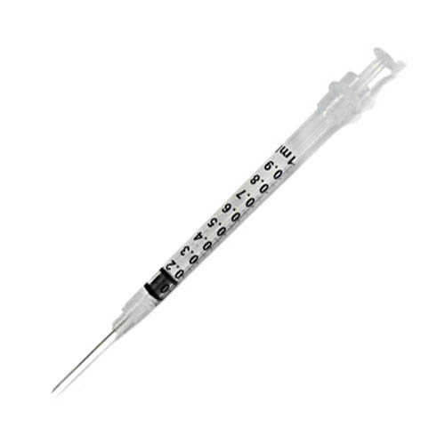
Quantifying the total benefit of vaccines
However for many vaccines, the public health benefit depends on both the direct effect and indirect effect that results from blocking transmission
To quantify this total benefit of the vaccine we need to evaluate changes in aggregate rates of disease that occur after vaccine introduction
To do this, we perform time series analysis to quantify declines in disease rates following introduction of vaccine
http://theroadtodomestication.com/wp-content/uploads/2015/07/IMG_6746-1565.jpg
https://i2.wp.com/www.lifewithgremlins.com/wp-content/uploads/2014/07/holy-snot.jpg?zoom=2.625&fit=570%2C363&ssl=1&resize=166%2C95

Slide 11
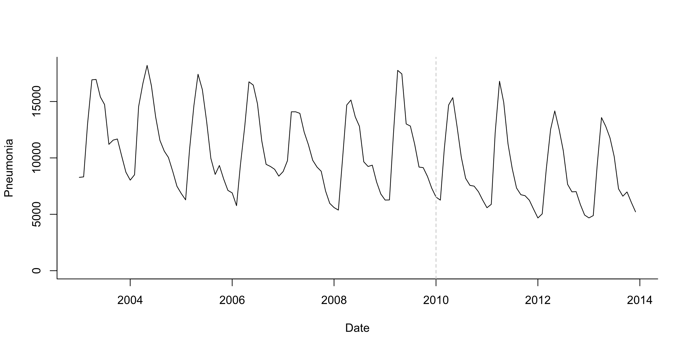
What is a time series?
Number of cases per week/month/year
A monthly time series of pneumonia cases in infants in Brazil
Number of events
Time (in months)

Slide 12
How much does the frequency of cases or deaths decline following vaccine introduction?

Slide 13
Estimating the effect of vaccine
Vaccine intro
“Counterfactual”
Vaccine effect
Pre-vaccine
Post-vaccine

Slide 14
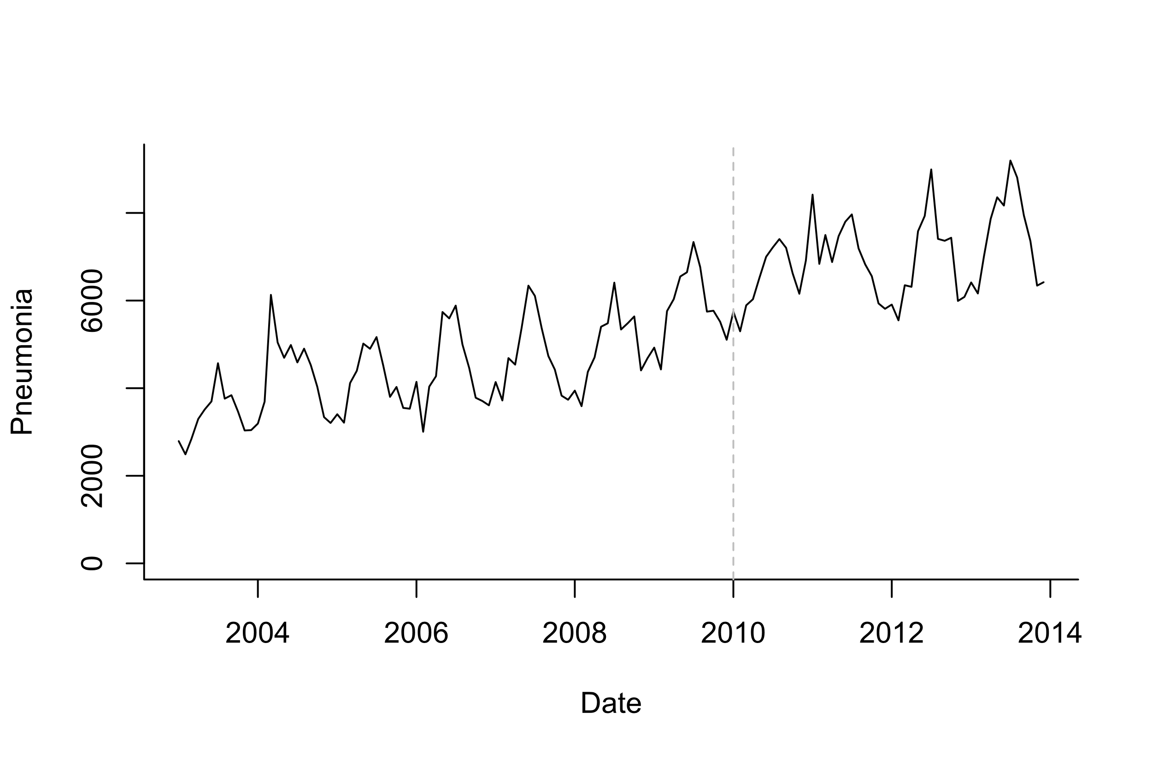
Estimating the effect of vaccine
?
Vaccine effect?
Pre-vaccine
Post-vaccine

Slide 15
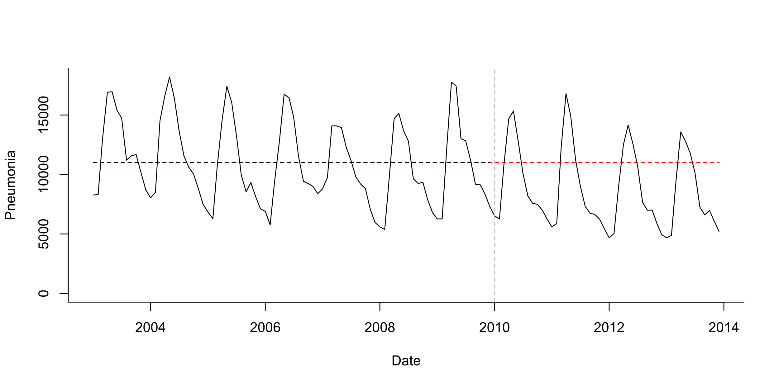
Pre-post analysis
Simple model:
Log(Pneumonia)=b0
Simplest case: stationary data ; no trends, no seasonality
Test whether mean number of cases declines post-PCV

Slide 16
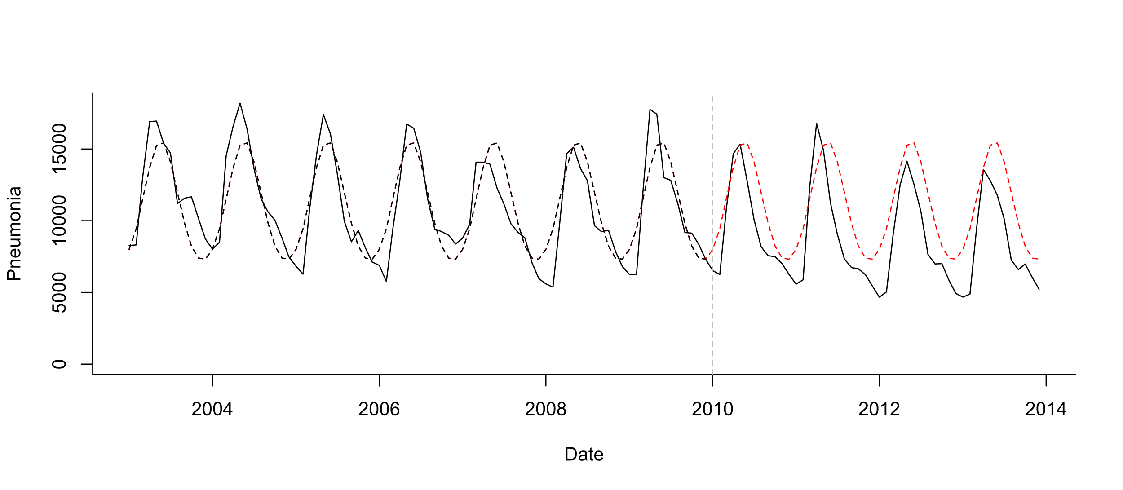
Pre-post analysis+seasonality
Seasonal model:
Log(Pneumonia)=b0 +b1*sin12 +b2*cos12
Test whether mean number of cases declines post-PCV

Slide 17
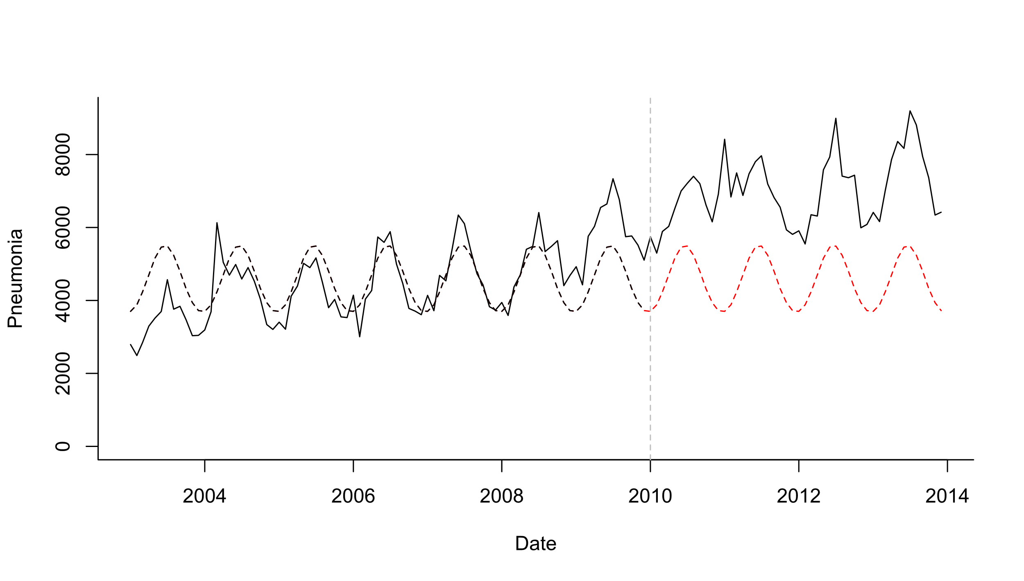
Pre-post analysis+seasonality
Seasonal model:
Log(Pneumonia)=b0 +b1*sin12 +b2*cos12
Test whether mean number of cases declines post-PCV

Slide 18
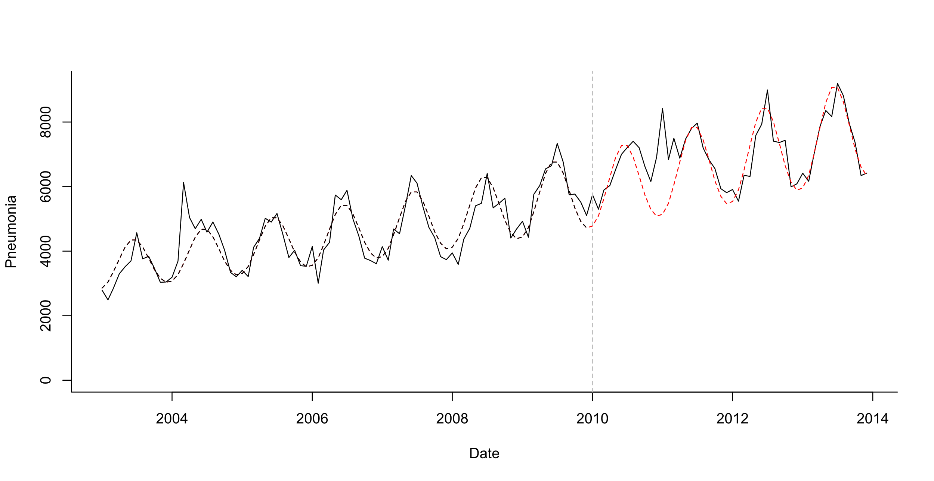
Pre-post analysis+seasonality + linear trend
Test whether mean number of cases declines post-PCV
Seasonal model:
Log(Pneumonia)=b0 +b1*sin12 +b2*cos12 +b3*trend
What is your evaluation period?
Last 2 years? Last 3 years?

Slide 19
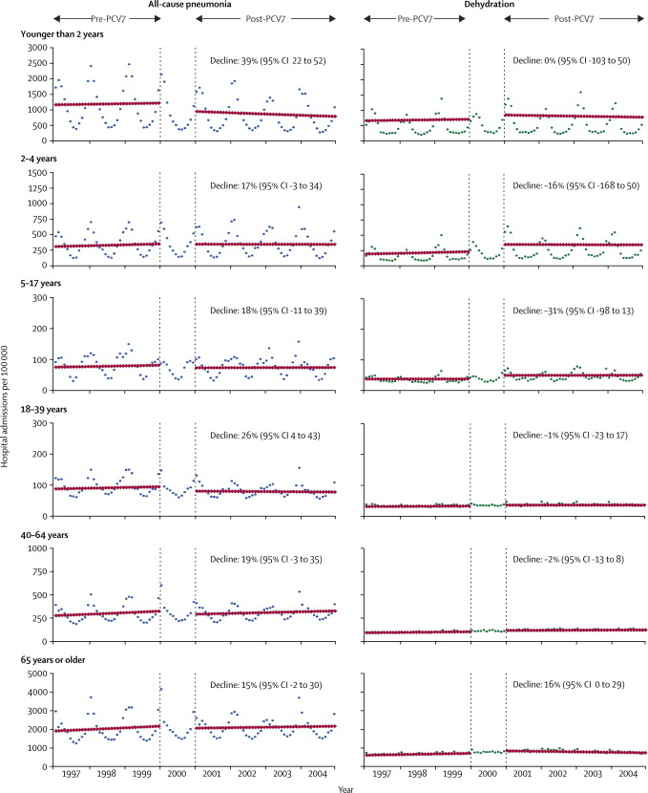
Evaluating impact of vaccines from time series
Counterfactual
Grijalva et al, The Lancet 2006
Pneumonia declines 39% compared to what would have been expected if not vaccine was introduced

Slide 20
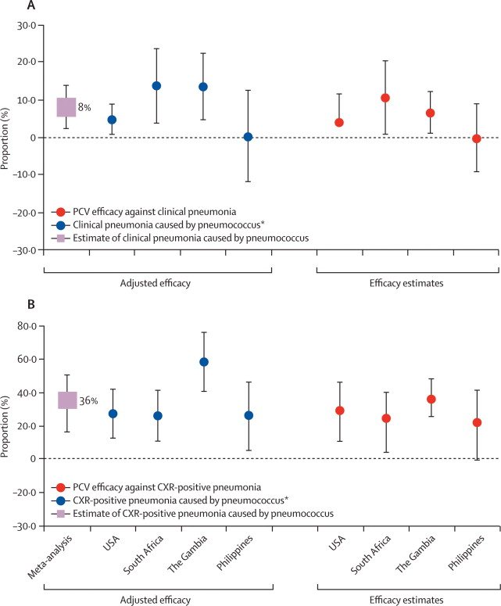
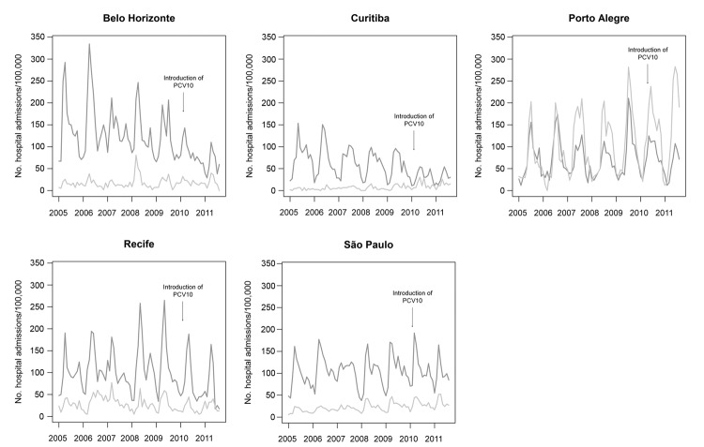
Why should you be skeptical of these types of analyses?
How much can the changes in all-cause pneumonia be attributed to PCV?
Trend studies: Variability; up to 40% declines
RCTs: ~8% Efficacy
Grijalva, The Lancet 2007
(Brazil)
2-23 month olds
-40.3%
Afonso, 2013 EID
O’Brien et al, The Lancet

Slide 21
Testing for a change in trend: Interrupted time series (ITS)
Does slope significantly change at time q
Predicted value at time t: Yt=exp(b+ a*t + c*z + d*t*z)
Counterfactual at time t: Yt=exp(b+a*t)
Difference or ratio between observed and counterfactual lines gives the “Vaccine impact” (rate ratio or rate difference)

Slide 22
Steps for evaluating change in trend
Define “baseline”, transition periods
Determine whether there are any trends or patterns in the baseline period
Seasonality, etc
Fit a model to your baseline data using regression
Be wary of over-fitting (use AIC)
Compare test and reference periods
THINK ABOUT WHAT COULD GO WRONG:
Identify controls!
Do sensitivity analyses!
i.e., leave out one season at a time; try different intervention times

Slide 23
Sensitivity analyses you should consider
Never trust your main analyses without “pressure testing” it
Try different intervention dates—how does it influence your estimate?
Leaving out different seasons when fitting, see if it changes the answer
Perform simulations to see how likely it is that you would detect a decline
https://weinbergerlab.shinyapps.io/ITS_Poisson_Power/

Slide 24
How much data do you need for a trend analysis?

Slide 25
Ability to detect a vaccine-associated decline
Depends on:
Size of the expected decline (ie a 40% decline is easier to see than a 10% decline)
Amount of unexplained variability in the data

Slide 26
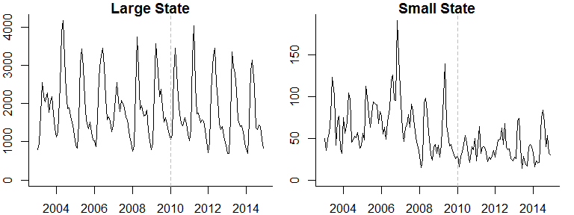
Pneumonia hospitalizations (N)

Slide 27
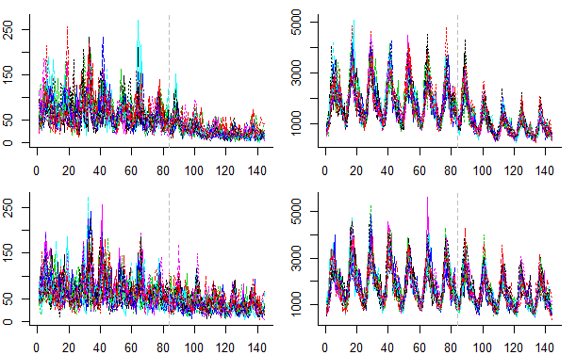
Simulated time series for a large and small state
20 Simulated time series for a small state
20 Simulated time series for a large state
50% reduction
20% reduction
https://weinbergerlab.shinyapps.io/ITS_Poisson_Power/

Slide 28
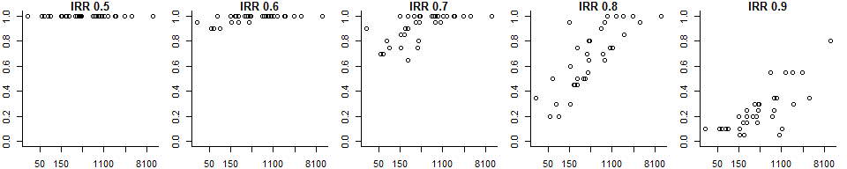
Power to detect a vaccine effect
Each dot on the plots below represents 1 of the 27 states
Each plot represents a different expected vaccine effect
Power: Percent of the simulations for which 95% CI for the rate ratio does not include 1
Expected vaccine effect (IRR)
Power
Average cases/month pre-PCV
With a smaller vaccine effect, only large states have adequate power
With a strong vaccine effect, even small states have excellent power to correctly detect the effect
All-cause pneumonia studies somewhere around here

Slide 29
Summary so far
Interrupted time series use linear trends to adjust for factors unrelated to vaccinations and to measure changes in the frequency of disease that occurs after vaccine introduction
The accuracy of these estimates and ability to measure it depends on the expected size of the decline and the amount of unexplained variation (noise) in the data
Typically have more noise in datasets from smaller populations

Slide 30
What else could go wrong with analyses?
Epidemic before or after vaccine introduction (biases slope estimates)
Ie 2009 pandemic, then introduce PCV in 2010
Insufficient data in pre- or post-period to accurately estimate trend
Unrelated changes that coincide with vaccine introduction
Delayed rollout of vaccine/low uptake
Many, many other issues that you can’t predict…

Slide 31
Simple pre/post vaccine comparisons to evaluate importance of different potential biases

Slide 32
Denominators/offsets
Commonly defined as number of cases per capita (incidence)
N_cases/N_people*100,000
But often database doesn’t cover all of the population
Coverage might change over time
Might want to use:
Number of people using healthcare system
Number of people who are hospitalized
Number of people receiving some test (e.g., Xrays)

Slide 33
Effect of denominator on estimates
~70% of Brazilian population uses public healthcare (SUS)
Varies by region and declines over time

Slide 34
Denominators
Choose a denominator that reflects changes in potential confounders
Change in all-cause pneumonia 2011-12 vs 2008-09 when using different denominators
 | Total population | Population using public system | All-cause hospitalization
Brazil | .89 | .92 | 0.85

Slide 35
Availability of hospital beds

Slide 36
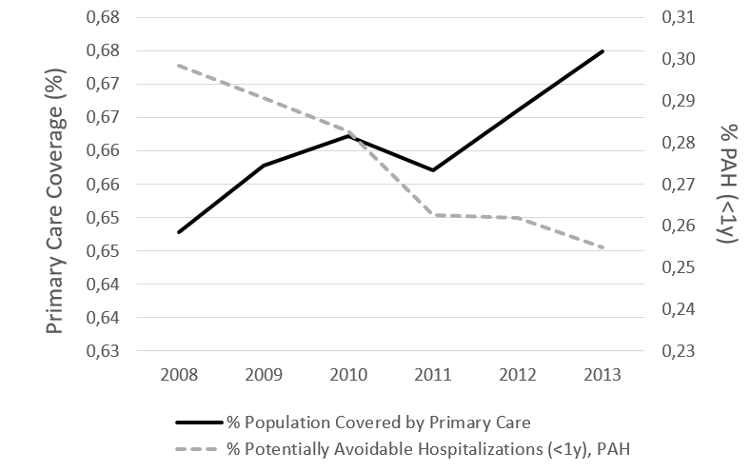
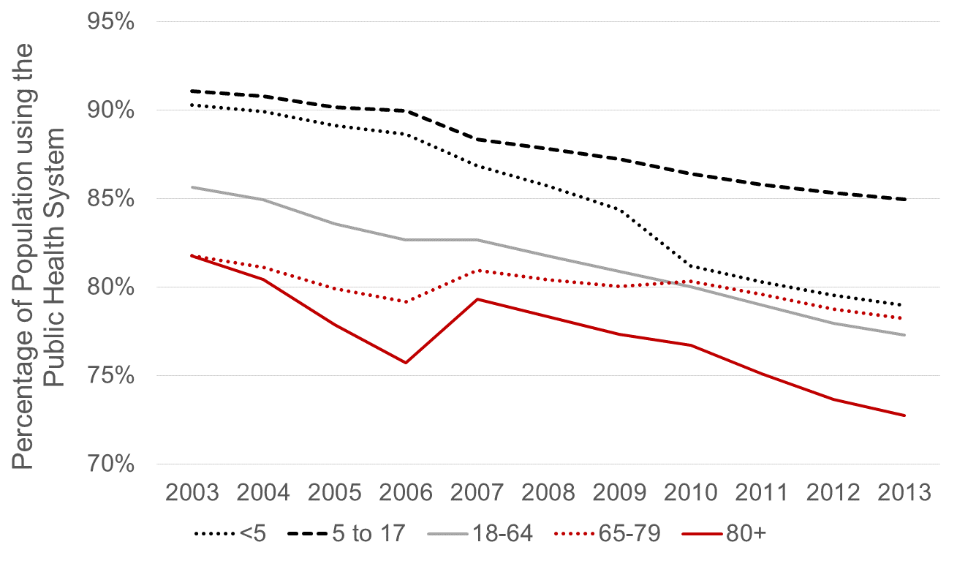
Many factors aside from vaccination can influence disease rates
Changes in access to primary care
Changes in use of public healthcare
Potentially-avoidable hospitalizations

Slide 37
Availability in hospital beds
More consistent (credible?) estimates

Slide 38
Effect of improvements in primary care

Slide 39
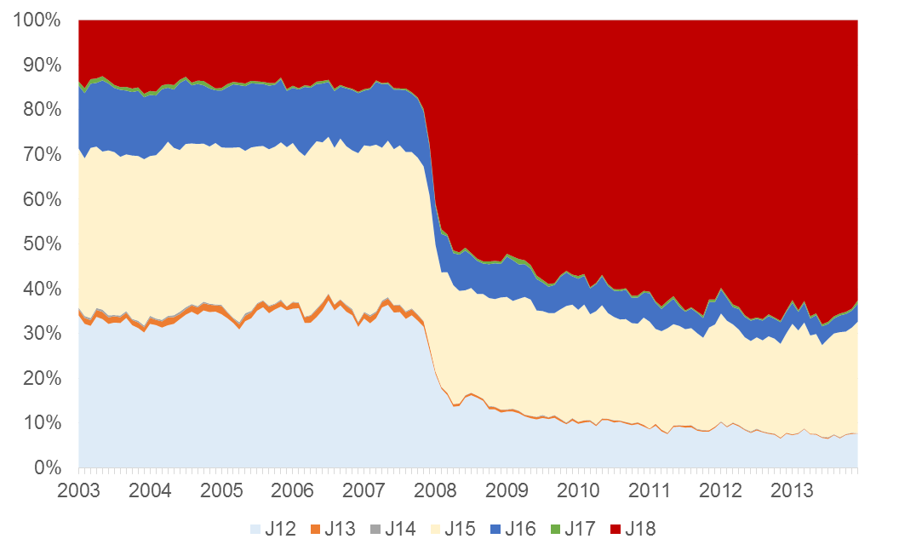
Changes in ICD coding practices
Changes in ICD coding
Pneumonia, unspecified

Slide 40
There are a lot of factors aside from vaccination that influence disease or death rates. What do we do about it?

Slide 41
Part 2: Adjusting for unexplained changes in incidence using control diseases

Slide 42
Use control diseases to detect/adjust for unrelated trends
Vaccine
Often used qualitatively
“Pneumonia declines but UTI is stable”
Can be used quantitatively
“Effect of PCV against pneumonia is X%-Y%”
Pneumonia
X% decline
Pre-vaccine
Post-vaccine
Time
Y% decline
Control disease
(e.g.UTI)
Pre-vaccine
Post-vaccine
Time

Slide 43
How does it work?
Control disease
Model fit
Pneumonia
Pre-vaccine
Post-vaccine
Time
Step 1: Fit a regression model using data from the pre-vaccine data to establish a
relationship between pneumonia and a control disease
E.g., log(pneumonia)= b0 + b1*log(control disease)

Slide 44
How does it work?
Control disease
Model fit
Pneumonia
Pre-vaccine
Post-vaccine
Time
Step 2: Plug in observed values for control disease from post-vaccine period to get an estimate for what counts of pneumonia would be

Slide 45
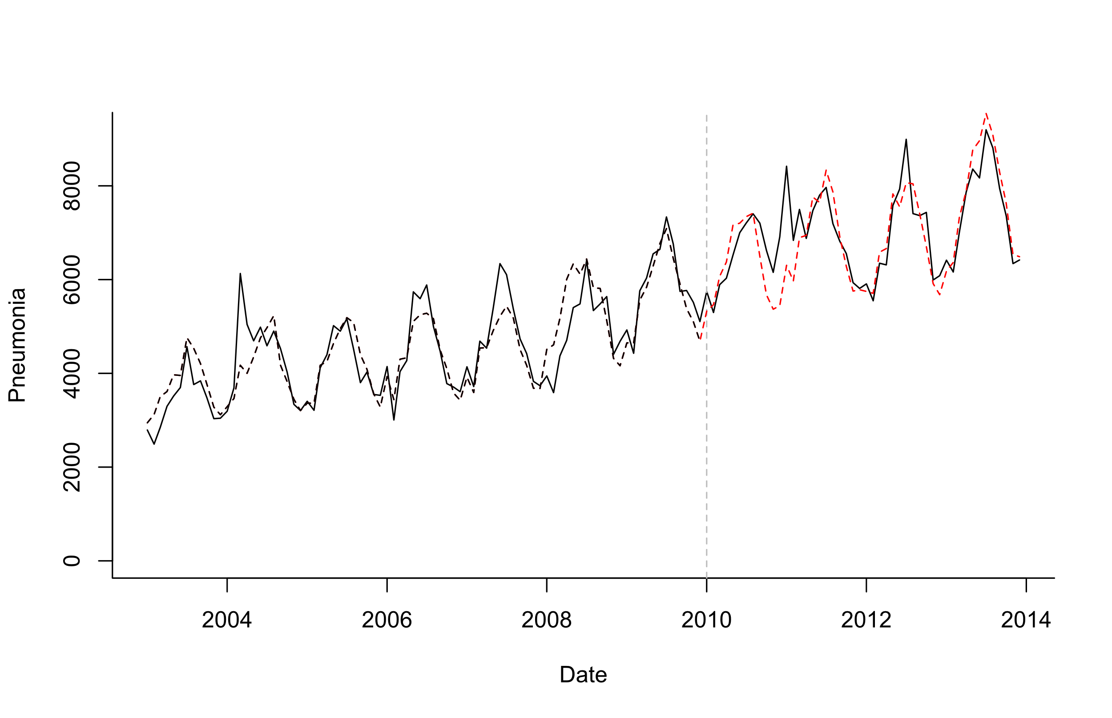
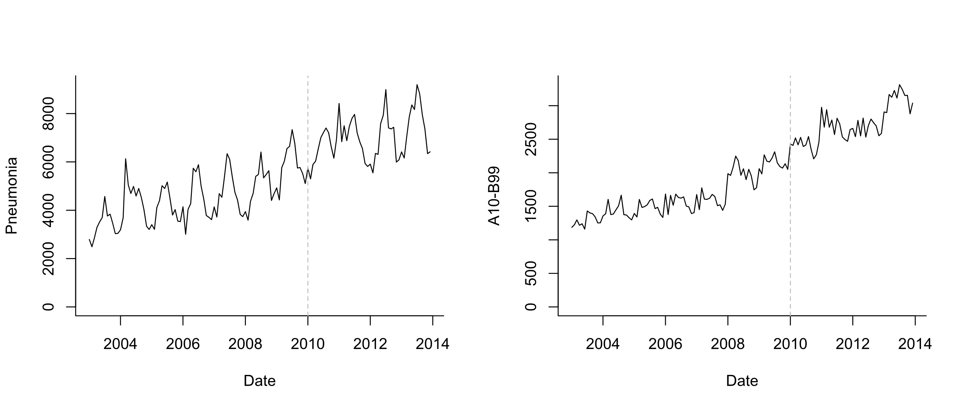
Possible control for pneumonia
Log(Pneumonia)=b0 +b1*sin12 +b2*cos12 +b3*log(A10_B99)
Model Fitting
Extrapolation based on controls

Slide 46
Key Assumptions
Relationship between pneumonia and control is stable over time and only change is due to the vaccine
Violated if there is an intervention that influences the control
Assumes control disease shares important non-vaccine trends with pneumonia
Vaccine does not affect control

Slide 47
What is a good control for pneumonia?

Slide 48
Example of control diseases
Key assumptions:
Control diseases are NOT affected by the vaccine
Relationships between pneumonia and other diseases would not change over time, if we did not introduce PCVs

Slide 49
What has been used as a control for PCV impact against pneumonia?
Urinary tract infections
Acute event
Definitely not influenced by vaccine
Only influences some age groups
Different etiology
Fractures
Might capture some broad healthcare utilization patterns (?)
Definitely not influenced by vaccine
Very different risk factors, causal mechanisms from pneumonia
Bronchiolitis
Closest in etiology to pneumonia
Possibly influenced by the vaccine
Only occurs in certain age groups

Slide 50
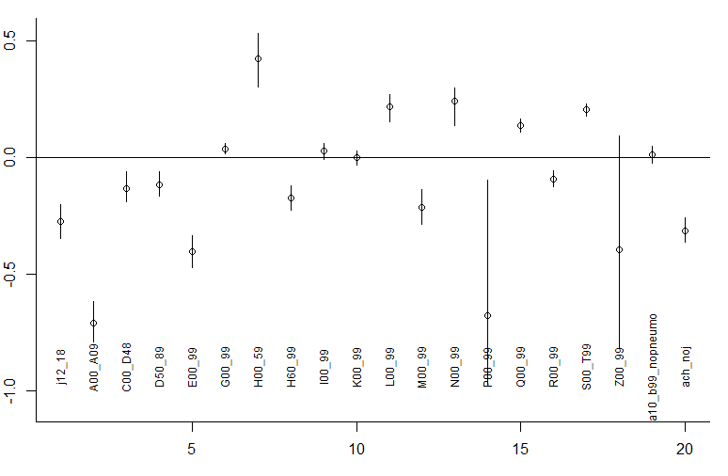
The challenge: Which control should we choose?
Changes in different disease categories post-PCV10
Log(Rate Ratio)
Infectious gastroenteritis
Diseases of the eye
Diseases of the geritourinary system
**Choosing a single comparator/control is risky—composites are more robust

Slide 51
The ideal control: Shares all causal factors, but is not influenced by vaccine
Regression: E(pneumonia cases_t)= b0 + b1*Perfect_control_t
The problem: how to identify a good control

Slide 52
Principles for selecting candidate controls
Exclude any that could plausibly be influenced by the vaccine (e.g. pneumococcal/streptococcal septicemia)
Relationship should be stable over time (e.g. exclude diarrhea following rotavax)
Exclude covariates with sparse data (<10 cases/month on average)

Slide 53
Letting the data select controls
Method developed by Google for website analytics (Brodersen)
Select large number of candidate controls a priori
Use Bayesian variable selection to give more or less weight to specific control diseases in the final model
Log(Pneumonia)=b0 +b1*sin12 +b2*cos12 +b3*control1+ b4*control2+ b5*control3…

Slide 54
What does synthetic controls do?
Outcome
(all-cause pneumonia hospitalizations)
ICD-10: J12-18
Control diseases
Various ICD-10 codes
34 diseases
(Children <12 mo in Brazil is used as an example)

Slide 55
What does synthetic controls do?
Fit regression model to pre-vaccine data only
Test different control variables alone or in combination
In forward or backward variable selection, you would drop less important variables
With this approach (Bayesian variable selection), you never drop any variables, you just give them more weight
Gives you a regression model with a set of controls that do the best job at explaining trends in pneumonia pre-PCV
Extrapolate to post-PCV period based on changes in the control variables

Slide 56
What does synthetic controls do?
Outcome
(all-cause pneumonia hospitalizations)
ICD-10: J12-18
Control diseases
Various ICD-10 codes
34 diseases
(Children <12 mo in Brazil is used as an example)

Slide 57
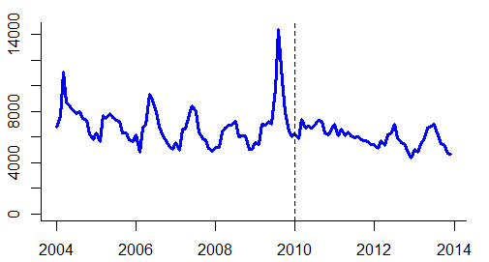
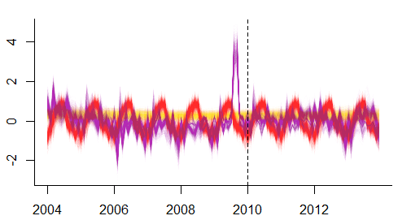
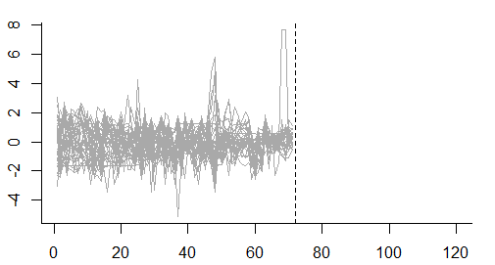
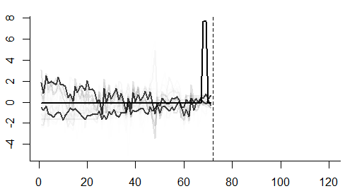
Original pneumonia time series
Regression model (and forecasts) include the synthetic control, seasonal variations, and random changes
Potential control variables
Training period
Evaluation
Controls are weighted based on similarities to pneumonia pre-PCV

Slide 58
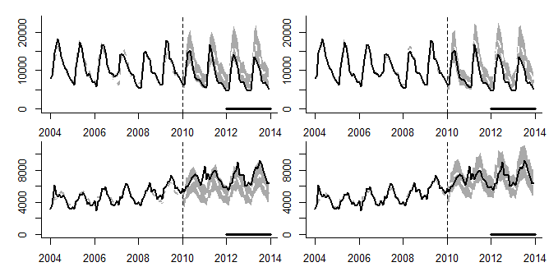
Example: Pneumonia in Brazil
Adjust only for non-respiratory hospitalizations
Adjust for synthetic control
A
B
<12 months
-23% (-30%,-16%)
-25% (-33%,-16%)
C
D
12-23 months
80+ years
+21% (+13%,+30%)
-0% (-12%,+14%)
-Synthetic controls do not affect estimates for <12month old children (no hidden biases detected)
-In adults >80, without synthetic control, would estimates a 21% increase, with synthetic control, no change

Slide 59
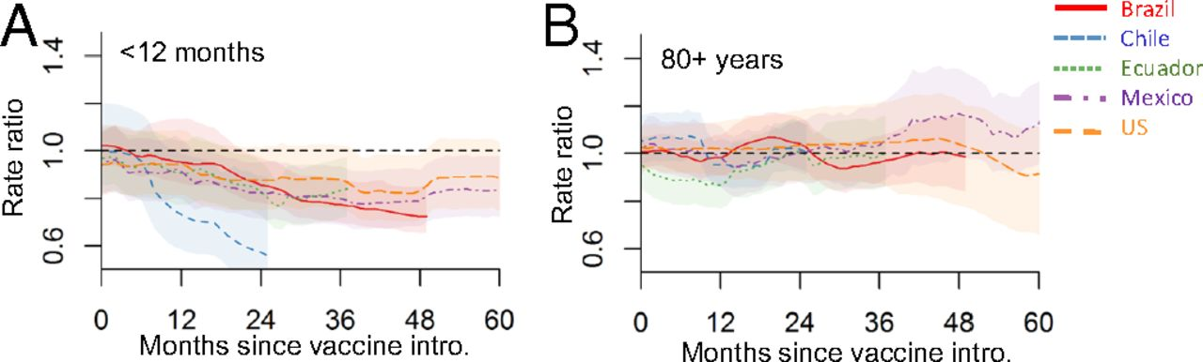
Trajectory of declines in five countries

Slide 60
Sensitivity analyses that are good to run
If have 6 years of pre-vaccine data, fit model to first 5 years, estimate “rate ratio” for 5th year
Should be ~1
Try dropping top 1,2,3 control variables; see if estimates change

Slide 61
Synthetic Controls: Pros and Cons
Provides flexible and robust approach to estimate vaccine impact
2 strong assumptions
None of the controls are influenced by the vaccine
The relationship between pneumonia and the controls does not change over time
Modifications needed for optimal use in small populations
Doesn’t guarantee you will detect/adjust for all confounding, but it increases the chances of success

Slide 62
What if we can’t identify appropriate controls because the data are too noisy?

Slide 63
Issues with Sparse Data
National:
PCV
Hard to assess correlations between the outcome and control diseases when data are noisy
Outcome
Controls
No. of cases (standardized, log)
SC model fails to select appropriate control disease(s) and generates unreliable prediction
What if we only observe 0.25% of cases? (ie small state in Brazil)
Outcome
Controls
No. of cases (standardized, log)
Notes:
A41: Other sepsis
I00_99: Diseases of the circulatory system

Slide 64
RRs from 100 down-sampled hospitalization datasets, 80+ yo in Brazil
National estimate of RR = 0.95
(represented by red dashed lines below)
Down sampling rate = 10%
Red dashed line: RR = 0.95 (national estimate)
Black line: RR = 1
100 down sampled datasets
RR

Slide 65
RRs from 100 down-sampled datasets
Not only CIs became wider but also RRs were biased away from the null
National estimate of RR = 0.95
(represented by red dashed lines below)
Down sampling rate = 10%
1%
0.25%
100 down sampled datasets
RR
RR
RR

Slide 66
Solution: smooth the control diseases

Slide 67
Sparse Approach
Control disease (I00_99)
Control disease (A41)
…
Control disease (G00_99_SY)

Slide 68
Sparse Approach
Step 1: Decomposition
Control disease (I00_99)
Trend
Seasonality
Remainder
Control disease (A41)
…
…
Control disease (G00_99_SY)

Slide 69
Step 2: Obtain a consensus trend
Step 1: Decomposition
Control disease (I00_99)
Trend
Seasonality
Remainder
Control disease (A41)
Consensus trend
…
…
Control disease (G00_99_SY)

Slide 70
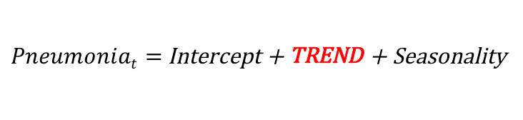
Step 1: Decomposition
Step 2: Obtain a consensus trend
Control disease (I00_99)
Trend
Seasonality
Remainder
Control disease (A41)
Consensus trend
…
…
Control disease (G00_99_SY)
Step 3: Regression
$Pneumoniat=$Intercept + TREND + Seasonality

Slide 71
 | Down samp. rate = 10% | 1% | 0.25%
SC model
New sparse approach
RRs are biased as data become sparse
RR
RRs are not biased. National estimate of RR is included in credible intervals
RR

Slide 72
Improved accuracy of sparse data approach
Down-sampling analysis
Simulation
SC model: Error increased as the data became sparse
Mean squared error
Sparse approach: Error remained small
Mean squared error
(sparse approach)
(sparse approach)

Slide 73
Reduced bias (Brazil state-level analysis, 80+ yo)
Synthetic controls data approach
Sparse data approach
Average number of pneumonia hospitalizations per year

Slide 74
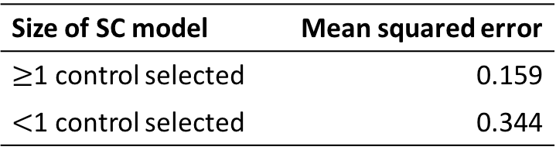
Among 100 down-sampled datasets, 4 successfully captured national estimate
RR
National RR
How were these 4 different from others?
Size of SC model | Mean squared error
$≥$1 control selected | 0.159
$<$1 control selected | 0.344
No. of control diseases selected in the SC model

Slide 75
Which analytical method is best?
Using a control disease is critical
Avoid simple time trend adjustment
At a minimum, adjust for all-cause mortality/hospitalization
If at least 1 control disease identified, use the results from synthetic controls
If no control diseases identified, it is often because the data are too sparse: use sparse data approach

Slide 76
Dan Weinberger, PhD and Kayoko Shioda, DVM, MPH
Epidemiology of Microbial Diseases at Yale School of Public Health
Flow Chart for Time Series Analysis of Pneumonia from admin data
Q1. Do you have at least 4 years of pre-vaccine data?
No
Be very cautious. It will be difficult to distinguish long-term trends from vaccine effects
Yes
Q2. Do you have control diseases?
No
Do simple interrupted time series analysis; as a sensitivity analysis, do change point analysis, block bootstrapping, etc.
Yes
Q3. Does the synthetic control method identify at least 1 control disease?
No
Use STL+PCA* , or alternative method to adjust trends
Yes
Use estimates from synthetic control method; as a sensitivity analyses, drop one control at a time
*STL+PCA: seasonal-trend decomposition based on LOESS + principal component analysis

Slide 77
Resources for using synthetic controls with administrative data
R package:
https://github.com/weinbergerlab/InterventionEvaluatR
Tutorial from Google
https://google.github.io/CausalImpact/CausalImpact.html
Original Google Paper
https://static.googleusercontent.com/media/research.google.com/en//pubs/archive/41854.pdf

